Slide 1


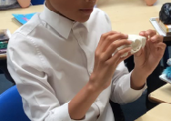
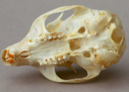
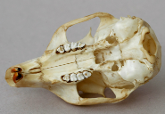
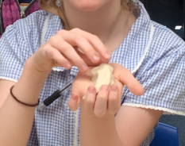
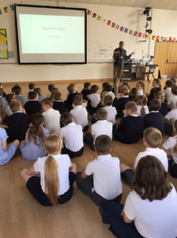
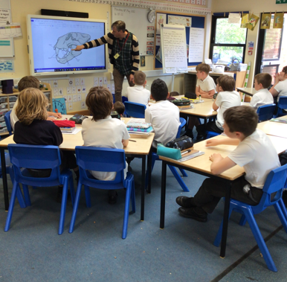
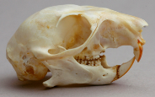
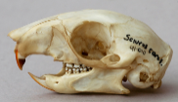

How is the shape of the red squirrel skulls on Mersea Island related to the food items available? Mersea Island School
Executive Fellow Andrew May BSc MSc FLS FCIEEM FRES CBiol FRSB Director of Landscape Conservation
Your STEM partner logo here
Our project
We live on an island that had no squirrel population initially so approx. 12 years ago red squirrels were introduced to the island and now seem to be thriving.
We want to inspire the children in our school with science that is local and relevant to them and understand more about the population of red squirrels on Mersea Island.
We aim to investigate the squirrels preferred habitats in Mersea.
Their diet preferences and how this is the same or differs from their grey relatives.
How the squirrel eats and if their jaw motion differs when eating soft or hard foods. We will work with a both Dr Cox and our local STEM partner, Andrew May undertaking investigations and experiments and field trips for students.
What we have investigated
Yr 4 children have been learning about teeth, how these are different in different animals and what this tells us about what they eat. Professor Cox join in some of these lessons and talked about the squirrel skulls, he shared a real skull and some 3d printed versions with the children for them to observe. The children then had a go at create model teeth for the different types of teeth they observed.
We then looked at the difference between red and grey squirrel jaws and the children made predictions about what they thought they might eat by looking at the shape and design of the teeth. They thought that the grey squirrels teeth looked stronger/ bigger, flatter and more worn and predicted that the grey squirrels would be able to eat harder nuts than the red squirrels. The grey squirrels skull was also bigger than the red so they thought they could eat bigger nuts.
What we have investigated
We held an Awareness Assembly to launch the project to the children and invited Professor Philip Cox and our STEM partner along to introduce them at the same time. We are also asking the Year 6 children to write an article for our local paper designed to inform and make the wider community aware of the project, the Royal Society and the project activities involving Dr Cox.
Our STEM partner is working with us to develop our outside area to make it more appealing to wildlife including the squirrels.
Red squirrel
Grey Squirrel
Next steps / what we have learnt through our investigation
Based on the year 4 predictions the children are going to begin to collect samples of what foods they spot the squirrels eating around the island to see what the reds are eating. We are also in contact with the local red squirrel social media page to liaise with the local community to share findings.
In the autumn term the Year 6 children will look more at this during their work on evolution and investigate the strength needed for jaws to open different nuts.
Year 2 and 4 will look at the habitats of the squirrels in Mersea and discover if the prefer particular trees.
We will also continue to build up our collect of 3D printing of jaws and teeth.

Slide 2
Guidance, checklist and permissions
Permissions and checklist
Before you submit your poster, please check the following:
  You have sought all necessary permissions for identifiable individuals in photos (please fill out the photo consent below in this case).
  You have checked the copyright for any images used that are from external sources, such as the internet or photo libraries, and have credited any individuals as needed.
  You have ensured no personal information has been shared (i.e. students names etc.).
  You have checked for scientific accuracy (i.e. no unfounded claims or theories have been presented).
  You have proofed the poster thoroughly.
Poster guidance:
Your poster must be submitted as a PowerPoint file no larger than 5MB. No other file format will be accepted.
Contact education@royalsociety.org with any questions
Format:
Please ensure your poster is kept in landscape layout.
Please do not change the format, positioning or size of the header (where the project title, names, school logo and STEM partner logo are) and the footer (scheme logo).
How you arrange the body of the poster is up to you but please align topics vertically or horizontally; diagonal movement can look messy. The information within the poster needs to fit between the header and the bottom of the page.
The font and type size in this poster should be kept consistent throughout. The text is Arial and size 18pt (black) for the body section should be used. Smaller text can be used for annotating pictures and diagrams as appropriate but should still be legible (size 14pt is a minimum).
Please be mindful of how small your images and text may appear on a standard screen and ensure you leave some blank space (gaps) between sections to make your poster easier to read.
Photography for use by the Royal Society
Permission for third party images used within Partnership Grants project posters, provided during grant reporting.
Date: XXX
Schools may provide the Royal Society with pre-prepared photography as part of the posters submitted as part of their mandatory reporting through the Partnership Grants scheme. These photographs, as part of the presentation documents, will be shared on the Society’s website, at Royal Society events and may be used in the media*. These photographs as part of the presentation documents could also be used in the following ways:
In printed or online material promoting the programme of activities run by the Royal Society, including (but not limited to):
  the Society’s website or social media sites, including Facebook, Twitter, LinkedIn and YouTube
  promotional flyers and banners
  in the media – newspapers, magazines, websites, broadcast outlets*
  in marketing and public engagement email campaigns e.g. newsletters
  in formal or public reports about the work of the Royal Society
It is the school’s responsibility to ensure that all third parties (including but not limited to: children, parents, staff) represented in the photographs have given their permission for the images to be distributed and used as detailed above. Please ensure you have checked your own schools’ photo permission policy, particularly with regards to children in local authority care (LAC).
It is the school’s responsibility to ensure that third parties who do not wish to be photographed, or have limitations of the photography’s use that exclude them from being used as above, are not included in any photography passed to the Royal Society.
The photographs as part of the presentation documents will be held in perpetuity for online, digital or print usage, while the content remains relevant. For any queries about permission relating to ongoing use, or to revoke permission for an individual, please email education@royalsociety.org
* Once a film/audio/story/photography has been used by an external media outlet, we are no longer able to control if it is used again by the same media outlet or potentially elsewhere.
I confirm that all people depicted in the photography provided from ……………….……………………………………………………
(Please insert school/college name above) have given all required permission or consent for the photography provided to be used for these purposes by the Royal Society.
Description of photography provided (brief description of picture – what is depicted and who is included)
Teacher / school representative’s details:
Name: Position in school:
Signature: Date:

