Slide 1


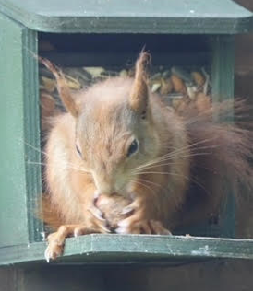
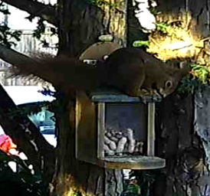
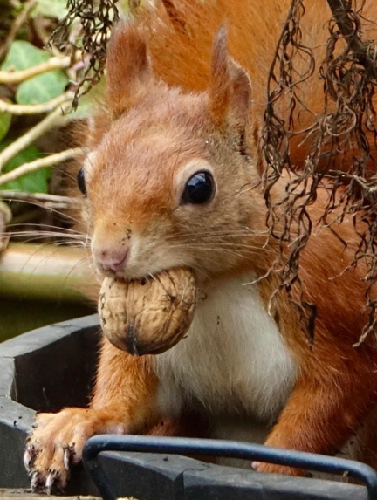
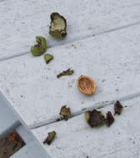
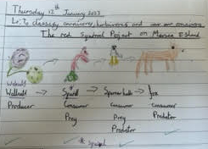
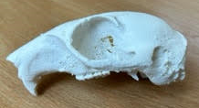
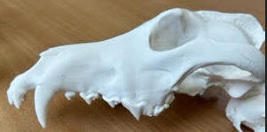
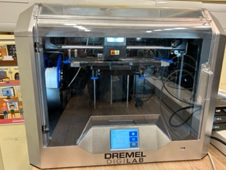
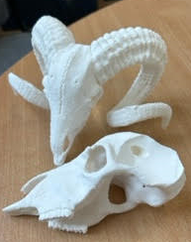
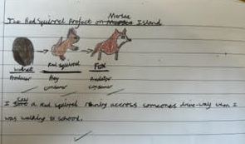

How is the shape of the red squirrel skulls on Mersea Island related to the food items available? Mersea Island School
Executive Fellow Andrew May BSc MSc FLS FCIEEM FRES CBiol FRSB Director of Landscape Conservation
Your STEM partner logo here
Our project
We live on an island that had no squirrel population initially so approx. 12 years ago red squirrels were introduced to the island and now seem to be thriving.
We want to inspire the children in our school with science that is local and relevant to them and understand more about the population of red squirrels on Mersea Island.
We aim to investigate the squirrels preferred habitats in Mersea.
Their diet preferences and how this is the same or differs from their grey relatives.
How the squirrel eats and if their jaw motion differs when eating soft or hard foods. We will work with a both Dr Cox and our local STEM partner, Andrew May undertaking investigations and experiments and field trips for students.
What we have investigated
The cameras bought with the grant money have been loaned to families from the school that have regular squirrel sightings and one put up on the school grounds with the support of our STEM partners advice on location along with the squirrel feeders to encourage the squirrels onto the school grounds- the children were very excited to see more regular sightings of the squirrels in our school gardens, particularly in the reception garden area near the squirrel feeder. The squirrels on Mersea are currently very active so all the children have been involved collecting food samples and taking photos of the squirrels they have seen.
What we have investigated
Our STEM partner has continued working with us to develop our outside area to make it more appealing to wildlife including the squirrels. We now have a regular Red Squirrel in our school field area.
The children and parents of the school have continued spotting Red Squirrels and collecting nut samples to share with Professor Cox. Cameras have been loaned out to families who regularly have Squirrel visitors and images shared with children back in school.
Year 4 have been investigating the Red Squirrel habitats and food chains in preparation for looking at their teeth and jaws next half term. In Mersea the Red Squirrels seem to prefer eating walnuts from the wild and banana chips in the squirrel feeders. The have found they like the local walnut trees and think they tend to hid often in the thicker fir trees. They found the most common threats to the squirrels were human (they get run over by cars) and foxes (though they have not seen much evidence of this). They researched that some hawks and buzzards can also prey on the squirrels but have not seen this happen.
Year 6 studied Red Squirrels and looked at possible adaptions as part of their work on evolution, they investigated the strength of jaw needed for different types of nut.
We have been using the 3D printer to print squirrel jaws and the jaws of herbivores and carnivores ready for comparisons of teeth types.
Evidence of squirrel diet
Some of the squirrel pictures taken by children and families or our Bushcams for the project.
Next steps / what we have learnt through our investigation
We are going to continue to loan out the cameras to collect photos and engage families with the project.
Continue the sample food collection.
Our STEM partner is going to run an assembly about conservation and the Red Squirrels and work with the classes mentioned above. (this was postponed from last term due to work commitments.)
Year 4 are going to study jaws and teeth and compare different animals and uses of types of teeth to look at how the squirrels use their teeth to eat their chosen foods. Compare squirrel teeth with other rodents.
Year 5 are going to study the life cycle of our Squirrels, gestation etc. What evidence can we find that the squirrels are breeding in Mersea?
Set up our hides in the school field to try to observe our squirrels close up.

Slide 2
Guidance, checklist and permissions
Permissions and checklist
Before you submit your poster, please check the following:
  You have sought all necessary permissions for identifiable individuals in photos (please fill out the photo consent below in this case).
  You have checked the copyright for any images used that are from external sources, such as the internet or photo libraries, and have credited any individuals as needed.
  You have ensured no personal information has been shared (i.e. students names etc.).
  You have checked for scientific accuracy (i.e. no unfounded claims or theories have been presented).
  You have proofed the poster thoroughly.
Poster guidance:
Your poster must be submitted as a PowerPoint file no larger than 5MB. No other file format will be accepted.
Contact education@royalsociety.org with any questions
Format:
Please ensure your poster is kept in landscape layout.
Please do not change the format, positioning or size of the header (where the project title, names, school logo and STEM partner logo are) and the footer (scheme logo).
How you arrange the body of the poster is up to you but please align topics vertically or horizontally; diagonal movement can look messy. The information within the poster needs to fit between the header and the bottom of the page.
The font and type size in this poster should be kept consistent throughout. The text is Arial and size 18pt (black) for the body section should be used. Smaller text can be used for annotating pictures and diagrams as appropriate but should still be legible (size 14pt is a minimum).
Please be mindful of how small your images and text may appear on a standard screen and ensure you leave some blank space (gaps) between sections to make your poster easier to read.
Photography for use by the Royal Society
Permission for third party images used within Partnership Grants project posters, provided during grant reporting.
Date: 6.3.23
Schools may provide the Royal Society with pre-prepared photography as part of the posters submitted as part of their mandatory reporting through the Partnership Grants scheme. These photographs, as part of the presentation documents, will be shared on the Society’s website, at Royal Society events and may be used in the media*. These photographs as part of the presentation documents could also be used in the following ways:
In printed or online material promoting the programme of activities run by the Royal Society, including (but not limited to):
  the Society’s website or social media sites, including Facebook, Twitter, LinkedIn and YouTube
  promotional flyers and banners
  in the media – newspapers, magazines, websites, broadcast outlets*
  in marketing and public engagement email campaigns e.g. newsletters
  in formal or public reports about the work of the Royal Society
It is the school’s responsibility to ensure that all third parties (including but not limited to: children, parents, staff) represented in the photographs have given their permission for the images to be distributed and used as detailed above. Please ensure you have checked your own schools’ photo permission policy, particularly with regards to children in local authority care (LAC).
It is the school’s responsibility to ensure that third parties who do not wish to be photographed, or have limitations of the photography’s use that exclude them from being used as above, are not included in any photography passed to the Royal Society.
The photographs as part of the presentation documents will be held in perpetuity for online, digital or print usage, while the content remains relevant. For any queries about permission relating to ongoing use, or to revoke permission for an individual, please email education@royalsociety.org
* Once a film/audio/story/photography has been used by an external media outlet, we are no longer able to control if it is used again by the same media outlet or potentially elsewhere.
I confirm that all people depicted in the photography provided from Mersea Island School……………….……………………………………………………
(Please insert school/college name above) have given all required permission or consent for the photography provided to be used for these purposes by the Royal Society.
Description of photography provided (brief description of picture – what is depicted and who is included)
Teacher / school representative’s details:
Name: Jackie Elson Position in school: Science Subject Coordinator
Signature: J. Elson Date: 6.3.23

