Slide 1


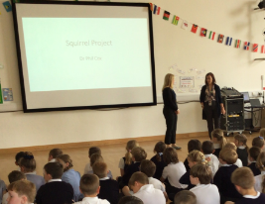
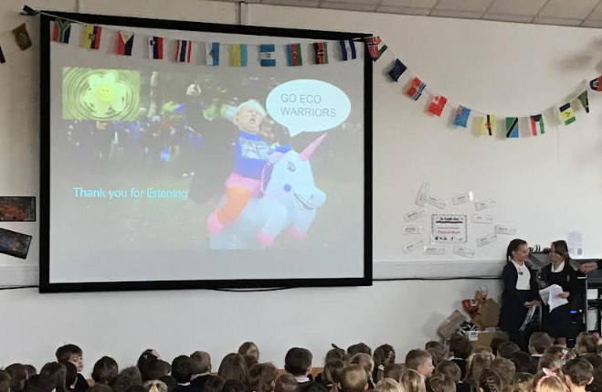
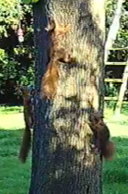
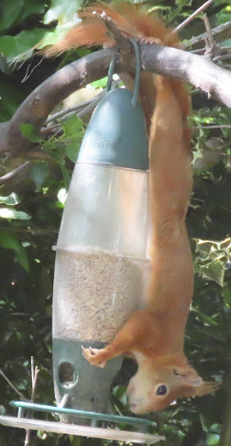
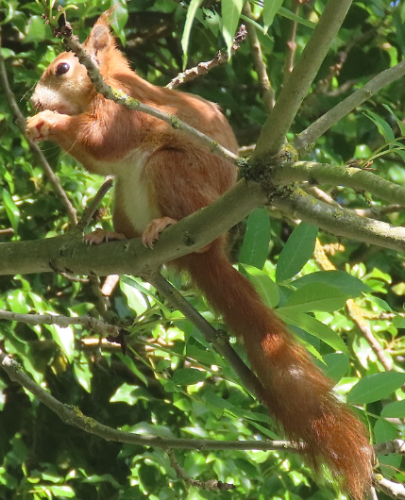
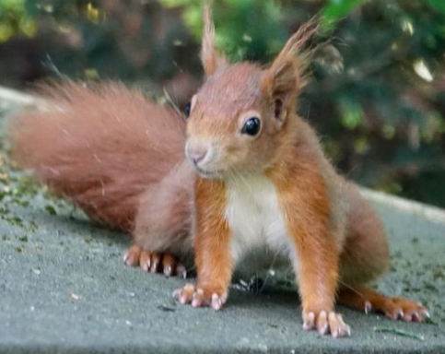
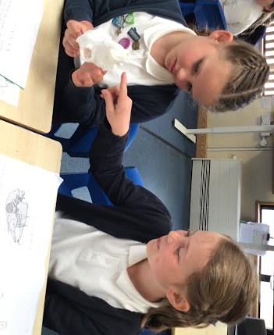
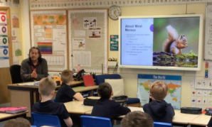
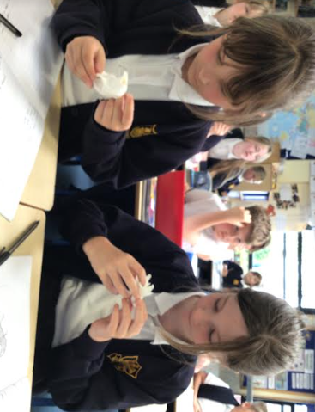
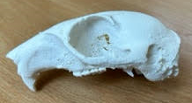
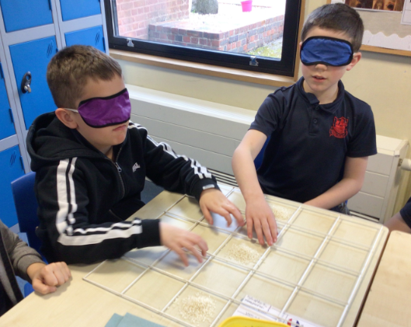
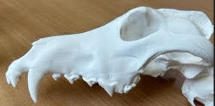

How is the shape of the red squirrel skulls on Mersea Island related to the food items available? Mersea Island School
Executive Fellow Andrew May BSc MSc FLS FCIEEM FRES CBiol FRSB Director of Landscape Conservation
Your STEM partner logo here
Our project
We live on an island that had no squirrel population initially so approx. 12 years ago red squirrels were introduced to the island and now seem to be thriving.
We want to inspire the children in our school with science that is local and relevant to them and understand more about the population of red squirrels on Mersea Island.
We aim to investigate the squirrels preferred habitats in Mersea.
Their diet preferences and how this is the same or differs from their grey relatives.
How the squirrel eats and if their jaw motion differs when eating soft or hard foods. We will work with a both Dr Cox and our local STEM partner, Andrew May undertaking investigations and experiments and field trips for students.
What we have investigated
The cameras and hides bought with the grant money have been loaned to families from the school that have regular squirrel sightings and put up on the school grounds with the support of our STEM partners advice on location along with the squirrel feeders to encourage the squirrels onto the school grounds- the children were very excited to see more regular sightings of the squirrels in our school gardens, particularly in the reception garden area near the squirrel feeder. We have been excited to spot some younger squirrels recently in the area.
Assembly to share squirrel photos and videos with the children
Our Eco warriors and STEM partner ran an assembly about our local area and ideas for all the children to help look after it.
What we have investigated
Our STEM partner has continued working with us to develop our understanding of how the squirrels feed and the differences between Red and Grey squirrels feeding habits.
The children and parents of the school have continued spotting Red Squirrels and collecting nut samples to share with Professor Cox. Cameras have continued to be loaned out to families who regularly have Squirrel visitors and images shared with children back in school.
Year 4 have been investigating the Red Squirrel their teeth and jaws and comparing them to other animals and teeth types. We have used the skulls we have printed using the 3D printer to make this learning come alive. Year 5 have been working with our STEM partner to look at how the Red Squirrels store and find food compared to their Grey counterparts. Our STEM partner explained that Red Squirrels are more forgetful and less organised with sorting the food so the Year 5 children did an investigation into how effective scattering food compared to organising in set places using grids and blindfolds. They decided that the squirrels need to be more organised to successfully retrieve the food they store more effectively!
Some of the squirrel pictures taken by children, families and from our Bushcams for the project.
One of our cameras was lucky to catch these 3 squirrels playing together on the tree!
Our STEM partner teaching Year 5 about squirrel feeding habits
Year 4 were very excited to learn about skulls and different teeth types and the roles they have in eating using our 3D printed teeth and skulls.
What we have learnt through our project
The children and adults (both staff and parents) have become passionate about protecting and supporting the Red Squirrel population on Mersea. The children have learnt about their life cycles, teeth, habitats and threats during the project and can now talk about our squirrels with confidence. The 3D printer has enabled us to bring previously paper based lessons alive and the children were much more engaged and remembered more from this way of learning.
Children have been excited to learn about something that is local and relevant to them and have been more engaged both in lessons and outside of school and it has strengthened our parent- school partnerships.
Our STEM partner has been an excellent role model to the children and many children aspire to have a similar job when they are older
Next steps - While our project ends officially at the end of this term, we are going to continue to loan out the cameras and hides to collect photos and engage families with our local wildlife as this has been so successful.
We will continue to learn and support the squirrels on our island and investigate other wildlife and plants that are unique to us in future science activities.
Year 5 Investigating feeding habit effectiveness

Slide 2
Guidance, checklist and permissions
Permissions and checklist
Before you submit your poster, please check the following:
  You have sought all necessary permissions for identifiable individuals in photos (please fill out the photo consent below in this case).
  You have checked the copyright for any images used that are from external sources, such as the internet or photo libraries, and have credited any individuals as needed.
  You have ensured no personal information has been shared (i.e. students names etc.).
  You have checked for scientific accuracy (i.e. no unfounded claims or theories have been presented).
  You have proofed the poster thoroughly.
Poster guidance:
Your poster must be submitted as a PowerPoint file no larger than 5MB. No other file format will be accepted.
Contact education@royalsociety.org with any questions
Format:
Please ensure your poster is kept in landscape layout.
Please do not change the format, positioning or size of the header (where the project title, names, school logo and STEM partner logo are) and the footer (scheme logo).
How you arrange the body of the poster is up to you but please align topics vertically or horizontally; diagonal movement can look messy. The information within the poster needs to fit between the header and the bottom of the page.
The font and type size in this poster should be kept consistent throughout. The text is Arial and size 18pt (black) for the body section should be used. Smaller text can be used for annotating pictures and diagrams as appropriate but should still be legible (size 14pt is a minimum).
Please be mindful of how small your images and text may appear on a standard screen and ensure you leave some blank space (gaps) between sections to make your poster easier to read.
Photography for use by the Royal Society
Permission for third party images used within Partnership Grants project posters, provided during grant reporting.
Date: 1.6.23
Schools may provide the Royal Society with pre-prepared photography as part of the posters submitted as part of their mandatory reporting through the Partnership Grants scheme. These photographs, as part of the presentation documents, will be shared on the Society’s website, at Royal Society events and may be used in the media*. These photographs as part of the presentation documents could also be used in the following ways:
In printed or online material promoting the programme of activities run by the Royal Society, including (but not limited to):
  the Society’s website or social media sites, including Facebook, Twitter, LinkedIn and YouTube
  promotional flyers and banners
  in the media – newspapers, magazines, websites, broadcast outlets*
  in marketing and public engagement email campaigns e.g. newsletters
  in formal or public reports about the work of the Royal Society
It is the school’s responsibility to ensure that all third parties (including but not limited to: children, parents, staff) represented in the photographs have given their permission for the images to be distributed and used as detailed above. Please ensure you have checked your own schools’ photo permission policy, particularly with regards to children in local authority care (LAC).
It is the school’s responsibility to ensure that third parties who do not wish to be photographed, or have limitations of the photography’s use that exclude them from being used as above, are not included in any photography passed to the Royal Society.
The photographs as part of the presentation documents will be held in perpetuity for online, digital or print usage, while the content remains relevant. For any queries about permission relating to ongoing use, or to revoke permission for an individual, please email education@royalsociety.org
* Once a film/audio/story/photography has been used by an external media outlet, we are no longer able to control if it is used again by the same media outlet or potentially elsewhere.
I confirm that all people depicted in the photography provided from Mersea Island School……………….……………………………………………………
(Please insert school/college name above) have given all required permission or consent for the photography provided to be used for these purposes by the Royal Society.
Description of photography provided (brief description of picture – what is depicted and who is included)
Squirrels, assembly photos, class activities, children, staff and stem partner are included in the photos. Permission has been given for these to be used.
Teacher / school representative’s details:
Name: Jackie Elson Position in school: Science Subject Coordinator
Signature: J. Elson Date: 1.6.23

