Slide 1
Relationships and Sex Education
(RSE)
Parent Information Evening

Slide 2
This compulsory subject has been introduced to help to keep children safe; prepare them for the world in which they are growing up, including the laws as they relate to relationships, sex and health; to help foster respect for others and for difference.”
Damian Hinds – Secretary of State for Education February 25th 2019

Slide 3
Facts and Myths
Children only need to know about puberty once it has started for them.
FALSE – Young people need to learn before the changes take place, as stated in the DfE RSE guidance.
2. Boys and girls should be taught separately.
TRUE – In some instances it may be more appropriate, but ensuring they are taught the same lesson.
3. Periods are a girl’s thing that boys do not need to know about.
FALSE – Boys should learn about periods so that they understand how male and female bodies work.

Slide 4
Facts and Myths
4. Sex education for 5 year olds includes teaching them about sex.
FALSE – At 5 it involves correct names for body parts, life cycles and special people in their lives.
5. There is no evidence that it (RSE) works.
FALSE – In the long term it can delay sexual activity and reduce pregnancy rates.
6. It encourages early sexual experimentation.
FALSE – There is no evidence to support this view. In fact the evidence suggests the opposite is true.

Slide 5
Facts and Myths
7. Good RSE teaching leads to more reporting of sexual abuse.
TRUE- Children who are taught about sexual abuse are more likely to tell an adult if they had or were experiencing it.
8. The best Relationships Education tells young people to abstain from sex until they are married.
FALSE – Effective RSE encourages young people to wait until they are ready. Just telling them to say no has little effect on changing behaviour.

Slide 6
Facts and Myths
9. 2% of girls do not learn about periods before they start.
FALSE- it’s nearly 25%
10. 10% of boys do not learn about wet dreams until they experience them.
FALSE – it’s 38%

Slide 7
The requirements
The Department for Education published statutory guidance for Health Education, Relationships Education and RSE in June 2019.
It is mandatory for primary schools to teach Relationships Education and Health Education and are strongly encouraged to teach Sex Education by the Department for Education- Summer term 2021
The policy aims to ensure that every child is guaranteed a PSHE education that covers mental health and wellbeing, physical health (including healthy lifestyles and first aid) and learning about safe, healthy relationships, including understanding consent and negotiating life online.
We started delivering our RSE curriculum in Spring 2021. We aim to complete the RSE unit in the summer term but this varies depending upon the cohort.
Notes:
4 years ago there was a consultation where by schools were asked thoughts and feeling around this subject. Mrs Hakwins was here at that time and did had a parent meeting.

Slide 8

SCARF
Safety, Caring, Achievement, Resilience and Friendship
Coram Life Education is the leading UK provider of relationships, health, wellbeing, and drugs education.
Trained Educators use evidence-based, interactive, engaging methods and resources to provide memorable learning experiences for 1 in 10 children in England and Scotland.

Slide 9
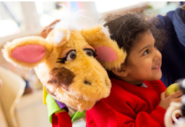

SCARF
Safety, Caring, Achievement, Resilience and Friendship
What children experience
Children’s experience of Coram Life Education’s sessions is fun, engaging and memorable. Children meet Harold, our giraffe puppet mascot (‘Healthy Harold’). They have discussions and watch short films about healthy eating, legal and illegal drugs and their effects, the body and how it works, and friendships and their influence. They begin to understand the impact of their choices and behaviours on every aspect of their health and wellbeing – and learn the skills and information needed to make positive, informed health choices.

Slide 10
SCARF
Safety, Caring, Achievement, Resilience and Friendship
What will my child learn in SCARF lessons?
Me and My Relationships
Valuing Difference
Keeping Myself Safe
Rights and Responsibilities
Being My Best
Growing and Changing

Slide 11
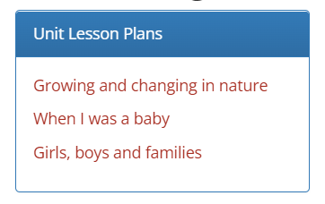
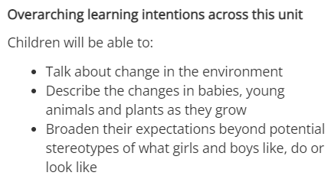
Nursery

Slide 12
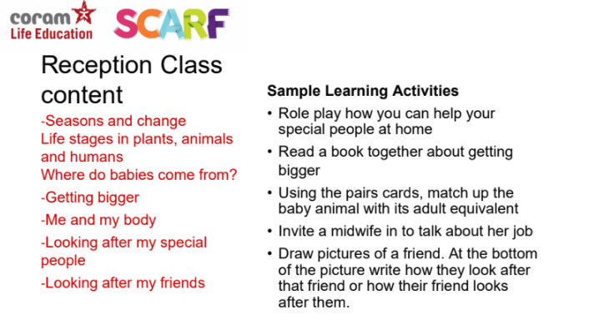
Reception

Slide 13
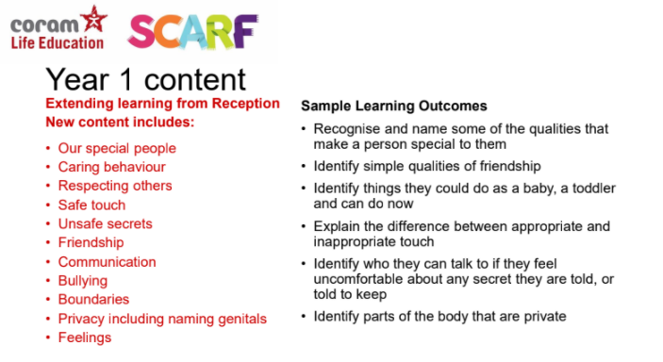
Year 1

Slide 14
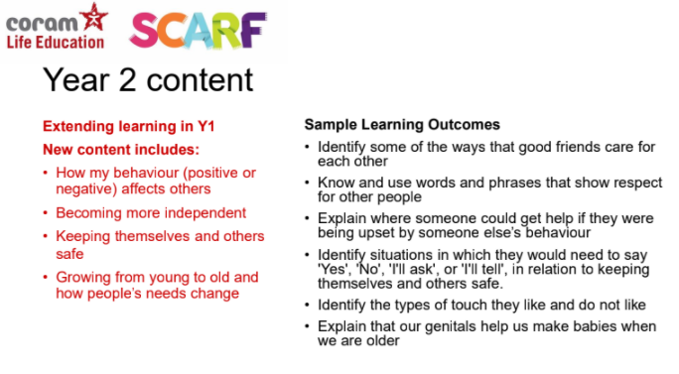
Year 2

Slide 15
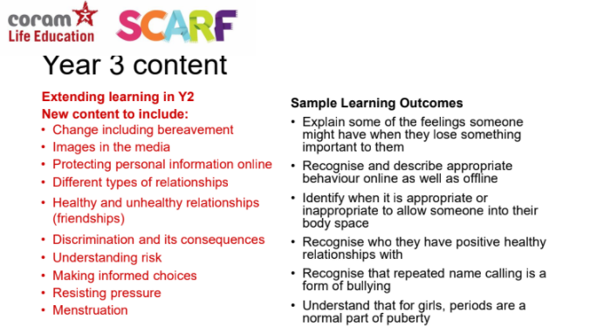
Year 3

Slide 16
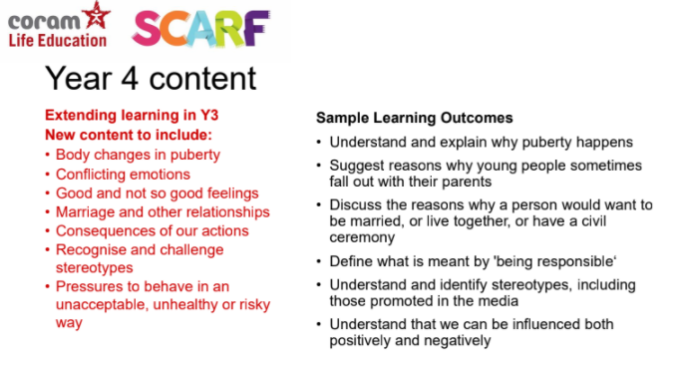
Year 4

Slide 17
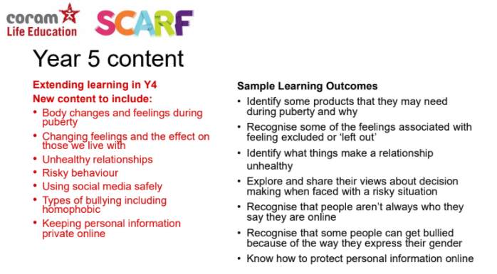
Year 5

Slide 18
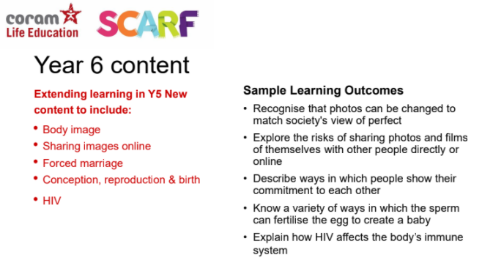
Year 6

Slide 19
SCARF
Relationships and Sex Education
We believe that children should learn about relationships as well as the emotional, social and physical aspects of growing up, human sexuality and sexual health in an age-appropriate way.
This goes beyond learning about relationships, to include puberty, how a baby is conceived and born, body ownership, and safeguarding.
Although we refer to our resources as our Relationship Education programme, they also include elements of Health Education as well as non-statutory sex education. Therefore we often refer to this as RSE: Relationships and Sex Education.
Our Relationships and Sex Education resources help children and young people to be safe, healthy and happy, both as they grow, and in their future lives. These lessons help to meet safeguarding, and emotional wellbeing requirements, as well as ensuring that schools cover the requirements of the DfE RSHE guidance.

Slide 20
SCARF
Safety, Caring, Achievement, Resilience and Friendship
How should schools include LGBT identities into RSE?
The Relationships Education, Relationships and Sex Education and Health Education statutory guidance (2019) states that:
“…schools should ensure that the needs of all pupils are appropriately met, and that all pupils understand the importance of equality and respect. Schools must ensure that they comply with the relevant provisions of the Equality Act 2010 … under which sexual orientation and gender reassignment are amongst the protected characteristics.” (section 36).
Notes:
Lots of you asked about the coverage with LGBT. We are looking at resourcing all year groups with appropriate text.

Slide 21
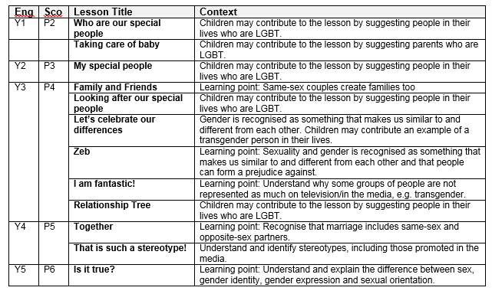
SCARF
Safety, Caring, Achievement, Resilience and Friendship

Slide 22
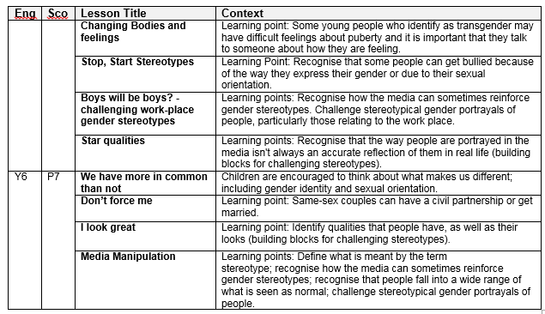
SCARF
Safety, Caring, Achievement, Resilience and Friendship

Slide 23
Common questions
Does SCARF cover non-statutory Sex Education?
There is very little in the SCARF programme that is non-statutory. We interpret sex education to mean puberty, conception, reproduction and birth. All of these themes, with the exception of conception, are statutory and included in either Health Education or National Curriculum Science.
The statutory guidance states that sex education should ensure children know how a baby is conceived. We interpret 'how a baby is conceived' as referring to what happens during sexual intercourse before an egg and sperm meet (reproduction). We therefore include sexual intercourse as well as IVF in our Year 6 Making Babies lesson.
Notes:
The only lesson that parents can take their children out off is the year 6 making babies lesson.

Slide 24
Common questions
What can I do to support with my child’s learning at home?
If you feel it is time to talk to your child about growing up and the changes they are likely to experience it’s best to offer it in small chunks, rather than do it in one go, often known as ‘The Talk’. This gives children time to digest the new information and ask you further questions as they develop more understanding.
If your child asks you questions try to stay calm, and not worry if you don’t know the answer. There are plenty of websites that you can use together to help you find the answers to their questions in a factual, honest, age appropriate way.
Use everyday opportunities to bring up the topic; things you see on TV or hear on the radio can be great conversation starters to talk about topics such as relationships, sex and body image. Reading books with your child is also a great way of introducing topics and helping children to understand themselves, their bodies and the world around them.

Slide 25
Common questions
What can I do to support with my child’s learning at home?
If you do have family names for genitals, ensure your child also knows their scientific names too. Nobody likes to think their child is at risk of abuse, but knowing the correct words for their genitals will help them report abuse if it did ever happen.
By showing your child that you are comfortable with them asking you questions now, you are helping to develop a relationship with them where they can seek your advice and support in their adolescent years.
Visit the specially created Coram Life Education SCARF webpage for more information including a list of books and websites that will support both you and your child along with some activities you to support their learning.

Slide 26
Common questions
How do I withdraw my child from non-statutory sex education?
Non-statutory sex education only applies to year 6.
A letter will need to be sent to your child’s class teacher.
A meeting will then be arranged with Mrs O’Flaherty and/or a senior member of staff to discuss.

Slide 27
Recommended websites
Useful websites for children
Amaze.org- Puberty section (Age 9+)
BBC Teach –The Big Talk (age 9-12)
Kids' Health - Menstruation
Male puberty - including wet dreams
NHS - stages of puberty
Outspoken - RSE worksheets
Useful websites for parents
Family Lives
NSPCC
Outspoken
Sex positive families
Sitting in car YouTube Channel: how to talk comfortably with your kids about sex and consent

Slide 28

Thank you

