Slide 1

Good Futures
Session One
A different way of thinking

Slide 2
What is autism?
Four areas of difference
Some different ways of thinking
Reasons for behaviour
Sources of support.

Slide 3
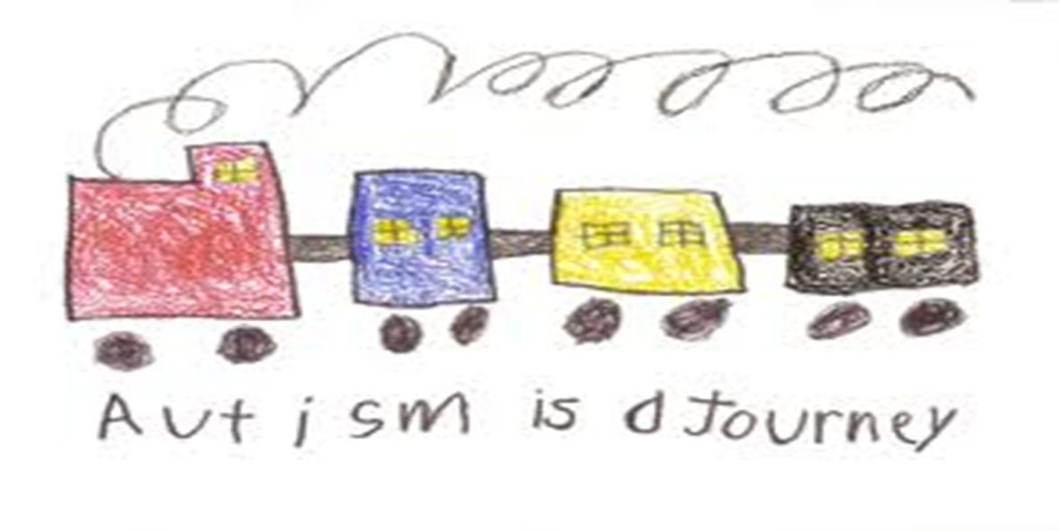

Slide 4

Dean Beadle
https://www.youtube.com/watch?v=XQh5H1MHkQQ

Slide 5
The history…
In the 1940’s two key figures who identified patterns of behaviour and abilities in a group of children and young people.
Leo Kanner – USA
Hans Asperger – Austria

Slide 6
In 1979 Lorna Wing and Judith Gould
highlighted difficulties in…..
Social interaction
Triad of impairment
Inflexibility of thought
Social communication

Slide 7
DSM 5 (Diagnostic and Statistical Manual)
- new diagnostic criteria
DSM 5 Gives generic diagnosis of autism spectrum disorder. Asperger syndrome will no longer be identified separately. (However it will not affect an individual’s current diagnosis unless they are reassessed.)
Triad of Impairments reduced to two areas:
  social communication and social interaction.
  restricted, repetitive patterns of behaviour, interests or activities. Sensory behaviours are included in this section.
at diagnosis the level of severity will be assessed - three levels - requiring:
1. support, 2. substantial support, 3. very substantial support.

Slide 8



Difference not deficit

Slide 9
Four areas of difference
Social interaction
Information processing
Sensory processing
Social communication

Slide 10
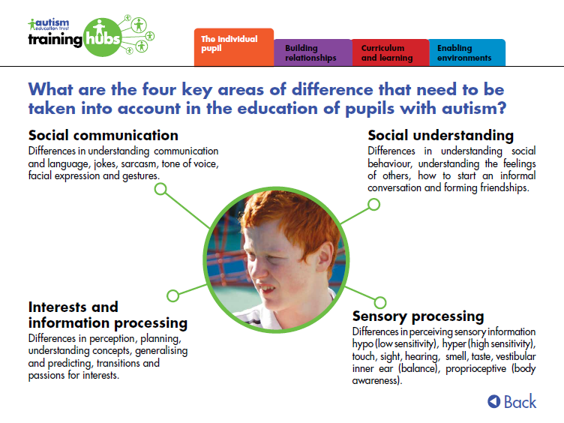

Slide 11
Social interaction
The child may:
not be interested in interacting with others
be passive but not respond to others
actively desire to have social contact, but do not know how to do so
have limited social awareness
have difficulty interpreting and expressing emotions and feelings
have difficulty with understanding non-verbal gestures, tone of speech.

Slide 12
Social communication
The child may:
have no spoken language or very little spoken language
speak in a manner that repeats or echoes words they have heard
like to talk a lot about something they are interested in and not be interested in listening to others
have an age-appropriate vocabulary
find it hard to understand what is said
understand language literally.

Slide 13
Information processing
The child may:
like to have the same routines
like things to be the same
like to repeat the same actions or activities
have special interests.

Slide 14
Sensory differences
Any or all of the 5 senses can be hypersensitive (over-sensitive) or hyposensitive (under-sensitive)
Touch: clothes, food, textures, pressures
Sight: colour, movement, peripheral
Taste: strength, aversion
Hearing: pitch, sensitivity, specific noises
Smell: recognition, aversion, overpowering.
https://www.youtube.com/watch?v=Lr4_dOorquQ

Slide 15
There are two more senses
Vestibular – balance
provides information about where our body is in space and whether or not our surroundings are moving. Tells us about speed and direction of movement.
Proprioception – body awareness
provides information about where a certain body part is and how it is moving.

Slide 16
Theory of mind
People with autism may have difficulties understanding that other people have different thoughts and feelings from themselves
This can lead to:
Appearing to be egocentric
Difficulty predicting and understanding what others may think from their ‘point of view’
Not being able to follow the games or ideas of others.

Slide 17
Executive function- performance of the frontal lobe of the brain
Implications of
Executive Function
differences
generalising skills
Planning actions and ideas
Starting and stopping
Perceiving of emotions
Pretend play

Slide 18







Cup: A small open container, usually with a flat
bottom and a handle, used for drinking.

Slide 19
Central Coherence
Some pupils will have difficulty in focusing on a whole topic, but will be preoccupied with fragments. Frith (1989)
Attention
skills
Seeing the whole picture
Preference for the known
Choosing and prioritising
Implications of differences in
Central Coherence
Seeing connections and generalising skills and knowledge
Organising self, materials and experiences
Making choices

Slide 20
‘It is extremely rare, in our experience, for a student with autism to be deliberately defiant…It is much more likely that the student does not understand the words used, the facial expression and body language of the speaker, or the social expectations of the situation…Non-compliance is rarely a useful concept in autism’. Gary Mesibov, co-founder of TEACCH

Slide 21
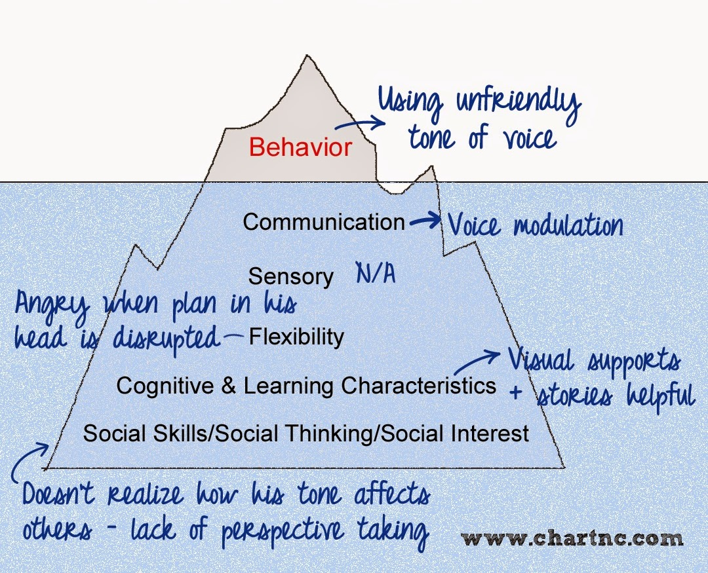
Understanding behaviour
Sensory?
Communication?
Information processing?
Social understanding?
Different perception?
Hungry/tired/ill?

Slide 22
What about strengths?
Good memory for facts
Knowledgeable and passionate in areas of particular interest
Strong visual learners
Attention to detail
Understanding rules and routines
Honesty
Living in the moment
INDIVIDUALITY!

Slide 23
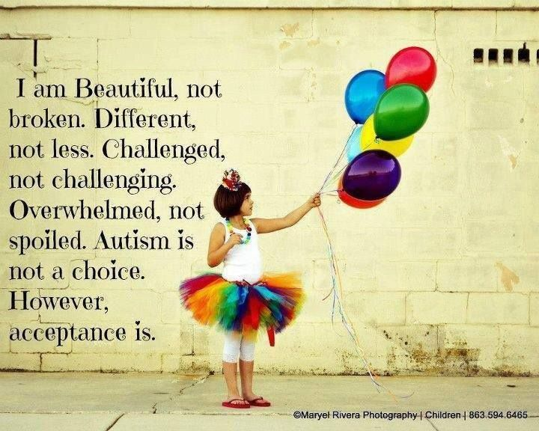

Slide 24



Local support groups

Slide 25

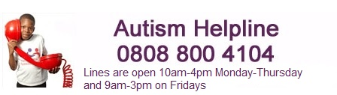
National Autistic Society
www.autism.org.uk

Slide 26

Autism Education Trust
www.autismeducationtrust.org.uk
Resources for parents and carers

Slide 27


