Slide 1


My Activity Passport
Mersea Island School
Thursday 10th November 2022

Slide 2

My Activity Passport
My activity Passport was launched by the then Education Secretary Damian Hinds in Dec 2018 as part of his drive to inspire primary school children to try new life experiences. From flying a kite or going on a nature trail. It underlines the importance of wider life experiences for each year group from reception to year 6 to complete both in and outside of school.

Slide 3
CARE Curriculum
As part of Mersea Island School’s exciting CARE curriculum (Community, Aspiration, Respect and Enjoyment), our vision is to inspire everyone to reach their unique and full potential.
The activity passport not only encourages academic achievement but also those experiences that provide excitement, enjoyment and fulfilment. Reading for pleasure, being excited by music and drama and being put slightly out of your comfort zone are all experiences that will help shape your child’s future, both in a practical sense as well as supporting their life skills and well-being.

Slide 4
Our Aim
Our aim is for every child to build character and resilience through enjoyable and varied experiences which are represented in some form in the passport’s list of age appropriate activities.
It can also help children to do better and achieve more at school.
The activities are designed to be accessible so that every child and family can get involved. They have been specifically adapted to suit Mersea School’s own unique island situation and we have also extended the Activity Passport to the older children in the nursery. We have also been lucky enough to have our own sponsors – The Mersea Island Tales Educational Trust – who we give our thanks to on the final page of the booklet.

Slide 5
My Activity Passport – how it works
.
The Activity Passport informs you of which homework activity you will be completing for that half term. Please do not be tempted to race ahead and get everything completed quickly as we can only sign off one homework task per half term.
When your child has completed a home activity please can they bring in evidence to the class teacher, who will then sign off the activity in your child’s passport, which is located in their homework books for KS2, their reading records for KS1 and reception and the bedtime book log for nursery.
At the end of the year there will be certificates awarded to those children who have completed their twenty challenges and had them signed off by their teacher.

Slide 6
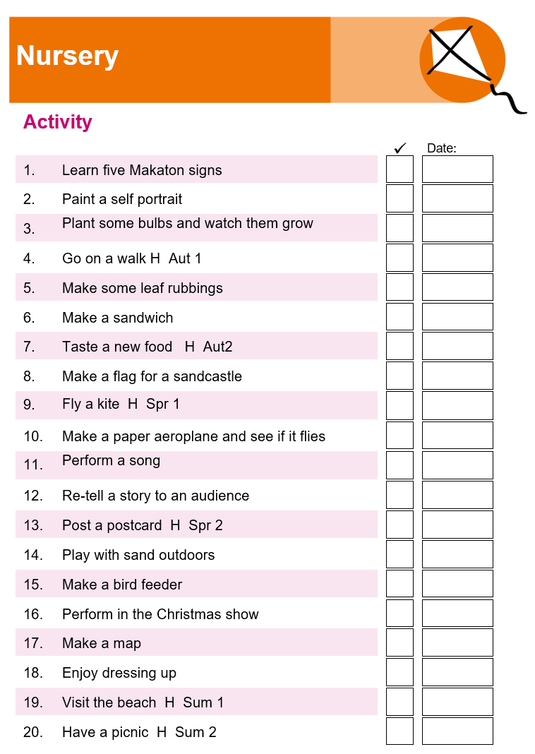
Nursery
Key Points
Role play
Speaking and listening
Story telling
Exploring nature

Slide 7
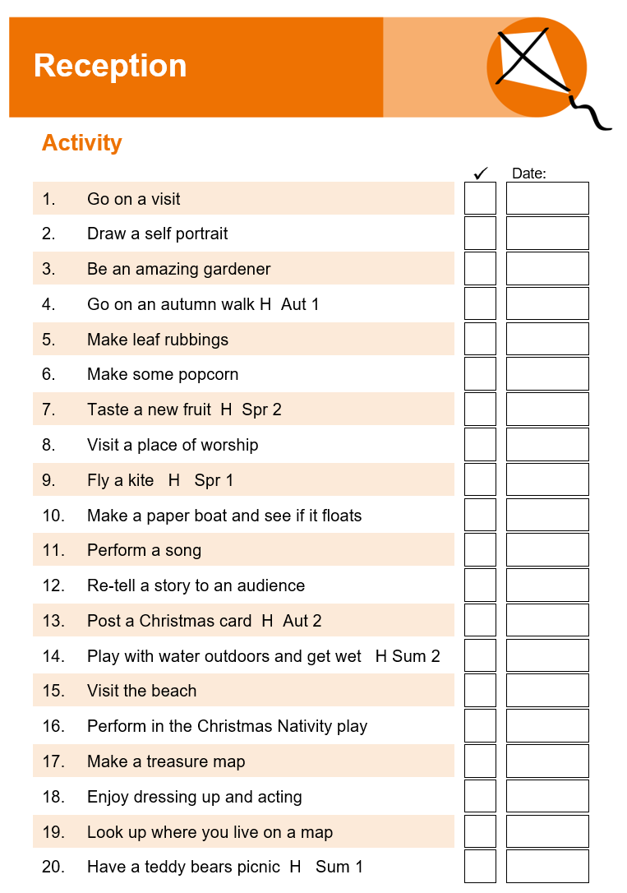
Reception
Curriculum Links
Building strong expressive skills
Being imaginative and communicating ideas
The Natural World
Role Play

Slide 8
Key Stage 1
Children in Key Stage 1 gain so much out of enrichment activities.
They can broaden pupil’s experiences, have fun and develop skills for life.
Not everything can be taught in the classroom and a child’s character, drive, resilience and ability to stick to a goal is just as important as their academic achievement.

Slide 9
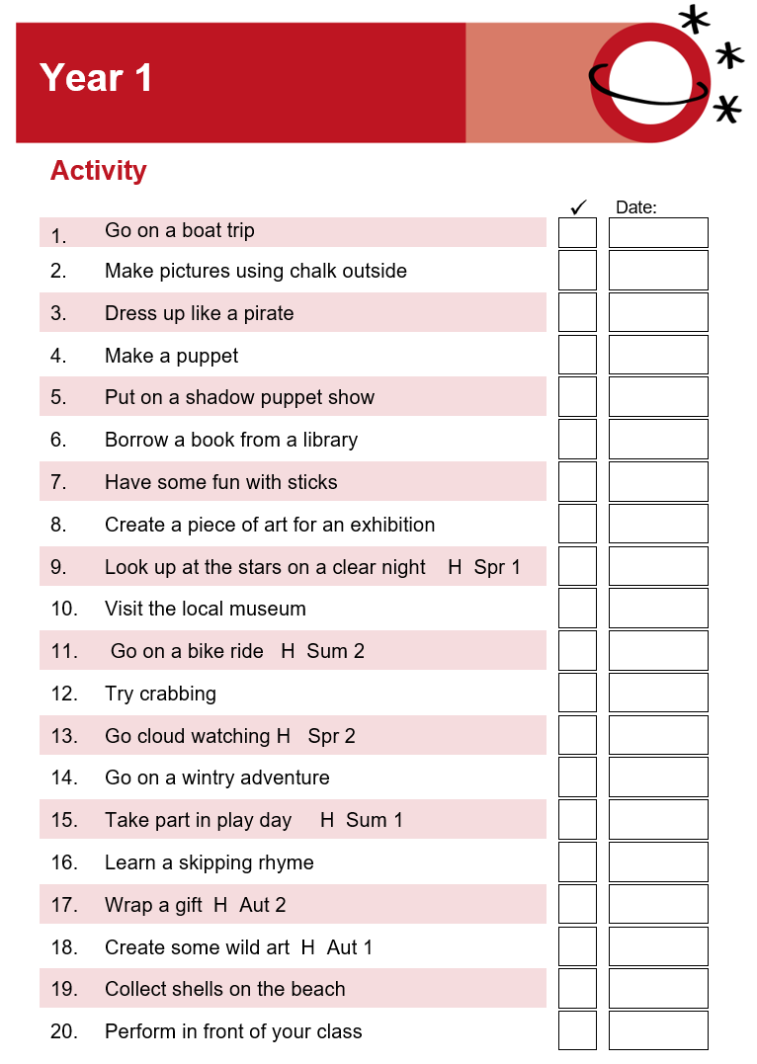
Year 1
Curriculum Links
Science – biology
Art – sculpture
English – speaking and listening

Slide 10
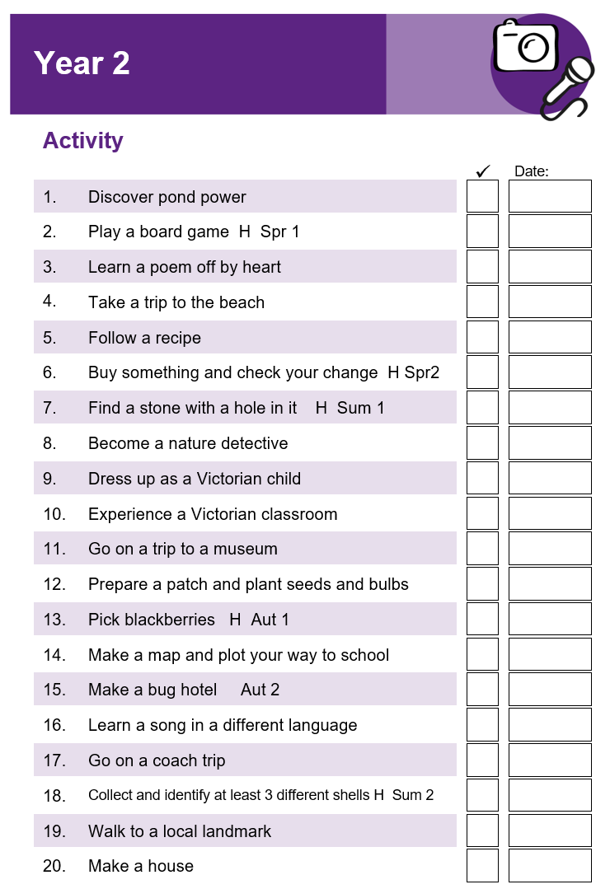
Year 2
Curriculum links
Science – working scientifically
Modern foreign languages
Maths – money
DT – design, plan and make

Slide 11
For Key Stage 2
We have included one final super activity challenge. It will be on the back page of the booklet.
It can be completed at anytime during Key Stage 2 ( Years 3-6)
We are asking children to prepare and perform a child led assembly on any suitable age- related subject of their choice.
When completed the child will need to fill in the subject and date of the assembly and ask the headteacher to sign.
Your child will be awarded a High Five badge from the Head Teacher for completing the assembly.

Slide 12
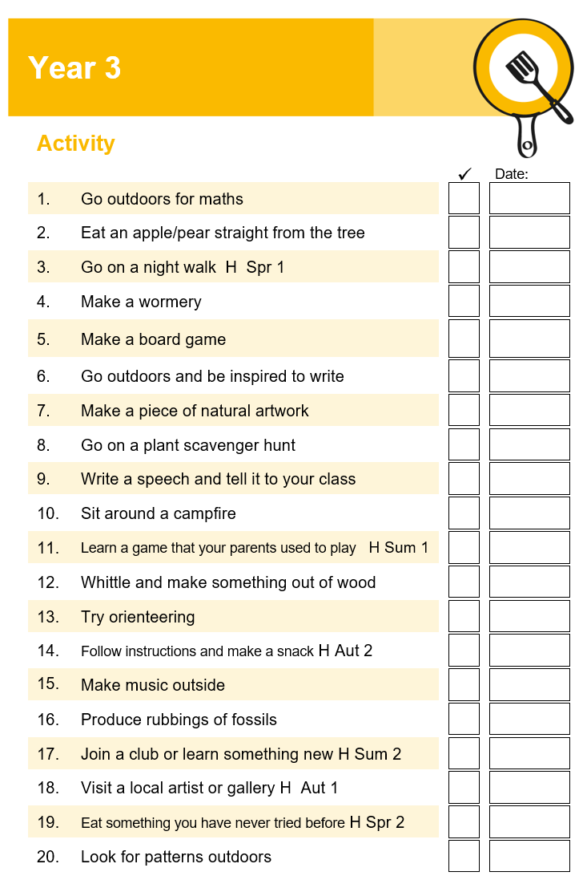
Year 3
Curriculum links
Science - living things ( classification and identification)
Music
History- Stone Age
English- instructions

Slide 13
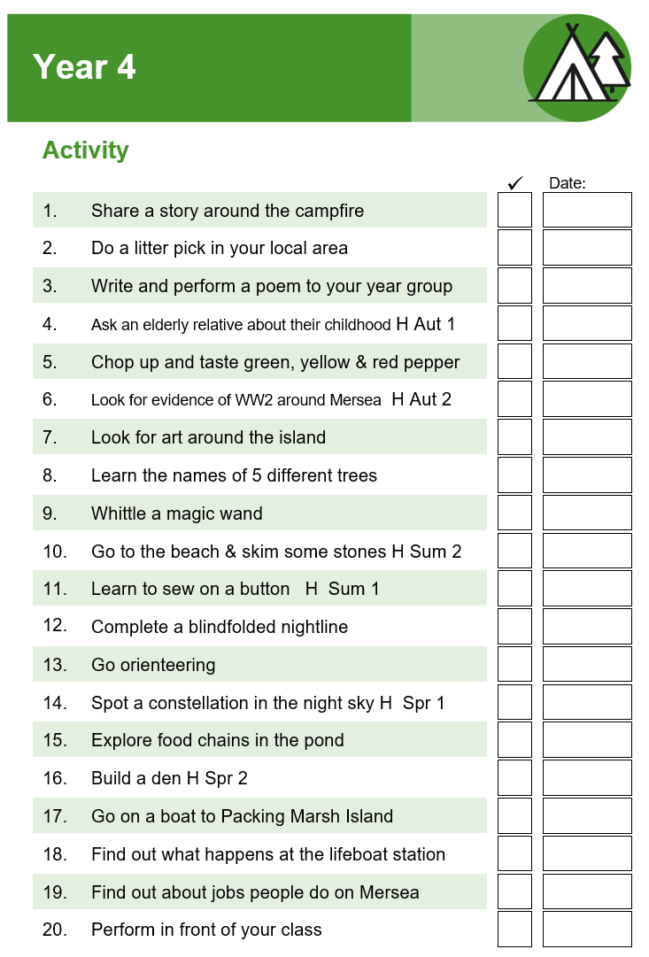
Year 4
Links to the curriculum
English - Harry Potter
English - Beowulf
Geography- Earning a Living
PE - orienteering

Slide 14
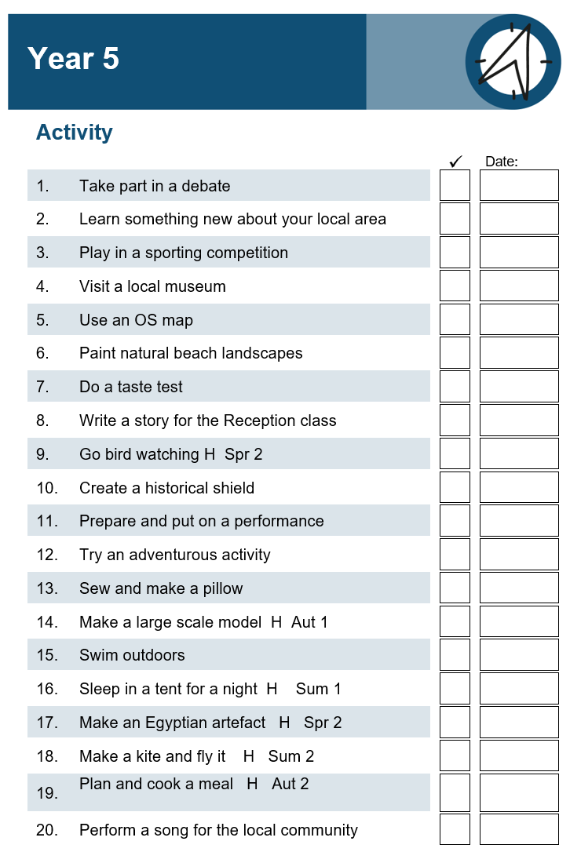
Year 5
Curriculum links
History – Egyptians
Science – Living things and their habitats
PE – outdoor activities

Slide 15
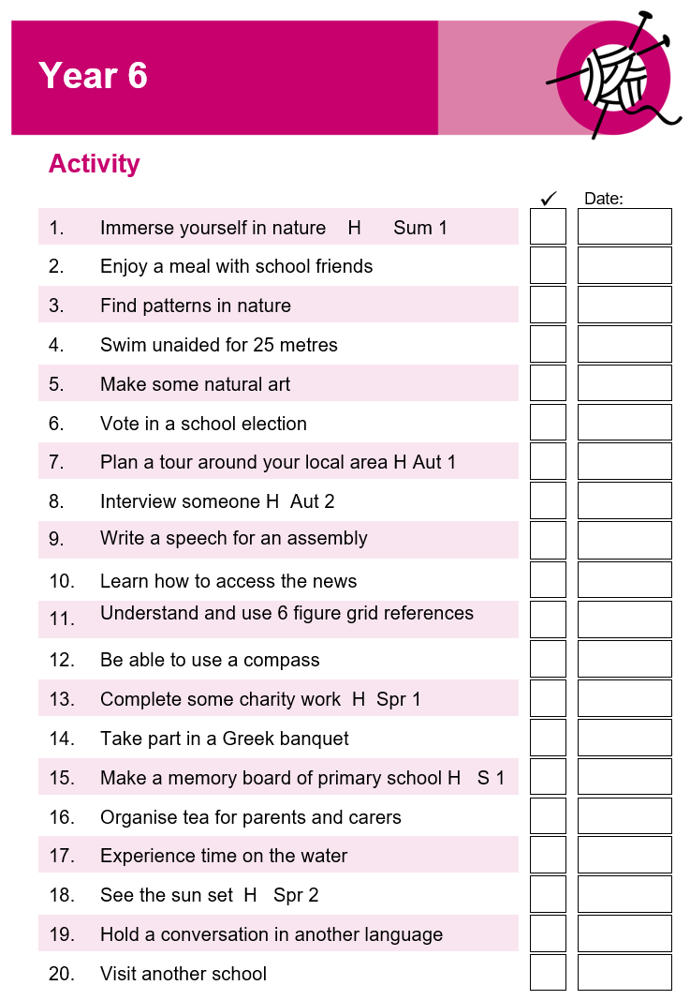
Year 6
Curriculum links
Geography – map skills
MfL - conversation
English – Kensuke’s Kingdom
History – Ancient Greece

Slide 16
My Activity Passport
Giving young people the opportunity to try new things and develop new skills can be hugely beneficial.
It can help young people to grow in confidence, expand their understanding of the world around them, or introduce a hobby or passion that could last for years to come.
I hope you and your child/children enjoys and succeeds in this exciting new journey.

Slide 17








Thank you to:

